Slide 1
C Tit - Bits

Slide 2
Incrementing and decrementing Pointers
main()
{
int *a, *s, i;
s = a = (int *) malloc(sizeof(int)*4);
for (i=0; i<4; i++) *(a+i) = i * 10;
printf("%d\n", (*++s)++);
printf("%d\n", (*s)++);
printf("%d\n", *++s);
printf("%d\n", ++*s);
printf("%d\n", ++s++);
}

Slide 3
Incrementing and decrementing Pointers – Result
main()
{
int *a, *s, i;
s = a = (int *) malloc(sizeof(int));
for (i=0; i<4; i++) *(a+i) = i * 10;
printf("%d\n", (*++s)++); //Increments address by 4 and then value
printf("%d\n", (*s)++); //Increments value only
printf("%d\n", *++s); //Increments address only
printf("%d\n", ++*s); //Increments value only
printf("%d\n", ++s++); //Error
}

Slide 4
Address Manipulations
main( ){
static int a[ ] = {0,1,2,3,4};
int *p[ ] = {a,a+1,a+2,a+3,a+4};
int **ptr = p;
ptr++;
printf("\n %d %d %d", ptr-p, *ptr-a, **ptr);
*ptr++;
printf("\n %d %d %d", ptr-p, *ptr-a, **ptr);
*++ptr;
printf("\n %d %d %d", ptr-p, *ptr-a, **ptr);
++*ptr;
}

Slide 5
Sizeof operator
int (*arr)[3][4];
printf("%d \n",sizeof(*arr));
printf("%d \n",sizeof(arr));
char *arr[3][4];
printf("%d \n",sizeof(*arr));
printf("%d \n",sizeof(arr));

Slide 6
Sizeof operator
int (*arr)[3][4];
printf("%d \n",sizeof(*arr)); // 48
printf("%d \n",sizeof(arr)); // 4
char *arr[3][4];
printf("%d \n",sizeof(*arr)); //16
printf("%d \n",sizeof(arr)); // 48

Slide 7
Tricky 1
main()
{
int i, j, *p;
i = 25;
j = 100;
p = &i; // Address of i is assigned to pointer p
printf("%f", ( I /*p )); // i is divided by pointer p
}

Slide 8
Tricky 2
void main()
{
Int *p = 5;
printf(“%d\n”,*p); // What is the value
}
//runtime error
If printf(“%d\n”,p);
//5

Slide 9
Tricky 3
main()
{
int x=1257;
int y=52;
float z;
z= (x / y);
printf("%d",z);
}
main()
{
int x=45;
float y=1.1;
int z;
z= (x * y);
printf("%d",z);
}

Slide 10
Tricky 4
main()
{
int x=3;
if((x++ < 1 && x++ < 3 ) || ++x >2)
printf("%d\n",x); //prints 5
}
main()
{
int x=3;
if((x++ < 6 && x++ < 3 ) || ++x >2)
printf("%d\n",x); //prints 6
}

Slide 11
Tricky 5
typedef int *p ;
main()
{
int a = 90 ; p p1 ;
p1 = &a ; printf("%d",*p1) ;
}

Slide 12
Answer
typedef int *p ;
main()
{
int a = 90 ; p p1 ;
p1 = &a ; printf("%d",*p1) ; // Prints 90
}

Slide 13
Tricky 6
What will be the output of the following program :
int main()
{
printf("%d"+1,123);
printf(“\123456789”);
printf(“\12345\\6789”);
printf(“\12345\102789”);
printf(“\12345\102789”+4,5);
printf(“%d”,printf(“HELLO”)+printf(“WORLD”));
printf(“%*.*f”,2,1,12.34);
“Print”+printf(“HelloWorld”);
return(0);
}
23
S456789
S45\6789
S45B789
789
HELLOWORLD10
12.3
HelloWorld

Slide 14
Tricky 7
What will be the output of the following program :
int main()
{
char s[100];
char t[100];
scanf(“%[abcd]”, s); ---- abcabded
scanf(“%s down %s”,s,t); --- hell down under
scanf(“%s %*s”,s); -----hell under
scanf(“%[^\n]”, s); -----hello world
return(0);
}

Slide 15
Tricky 8
#define islower(c) ('a'<=(c) && (c)<='z')
#define toupper(c) (islower(c)?(c)-('a'-'A'):(c))
main()
{
char *p="i am fine";
while(*p) printf("%c",toupper(*p++));
}
a) bcd
b) AFE
c) aFe
d) BCd

Slide 16
Answer
#define islower(c) ('a'<=(c) && (c)<='z')
#define toupper(c) (islower(c)?(c)-('a'-'A'):(c))
main()
{
char *p="i am fine";
while(*p) printf("%c",toupper(*p++));
}
a) bcd
b) AFE // Result
c) aFe
d) BCd

Slide 17
Pointers Revisited
Char *c ={ “Enter” , “NEW”,”POINT” , “FIRST” };
Char **cp[ ] = { c+3 , c+2 , c+1 , c};
Char ***cpp = cp;
Main()
{
printf("%s\n", **++cpp );
printf("%s \n", *--*++cpp+3 );
printf("%s\n", *cpp[-2]+3 );
Printf(“%s\n”, *cpp[-1]+6);
Printf(“%s\n”, *cpp[-1]+7);
}

Slide 18
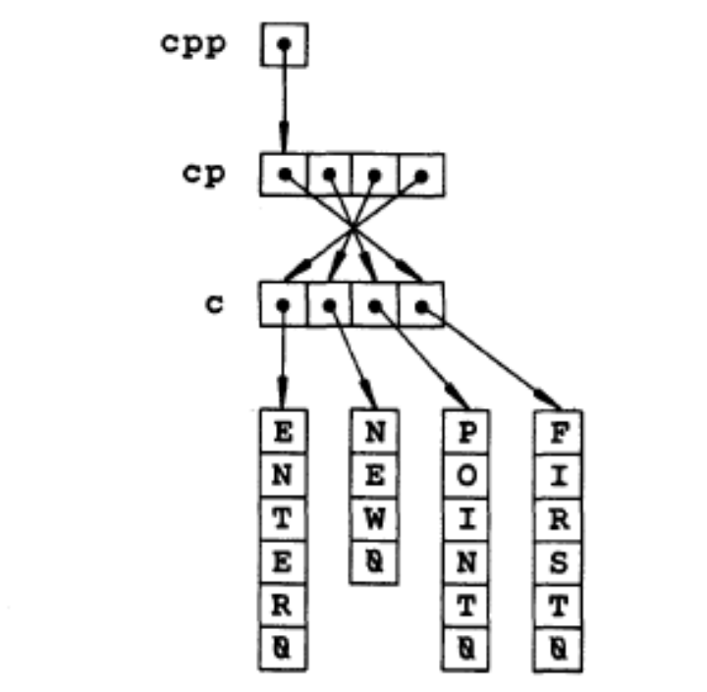
Char *c ={ “Enter” , “NEW”,”POINT” , “FIRST” };
Char **cp[ ] = { c+3 , c+2 , c+1 , c};
Char ***cpp = cp;

Slide 19
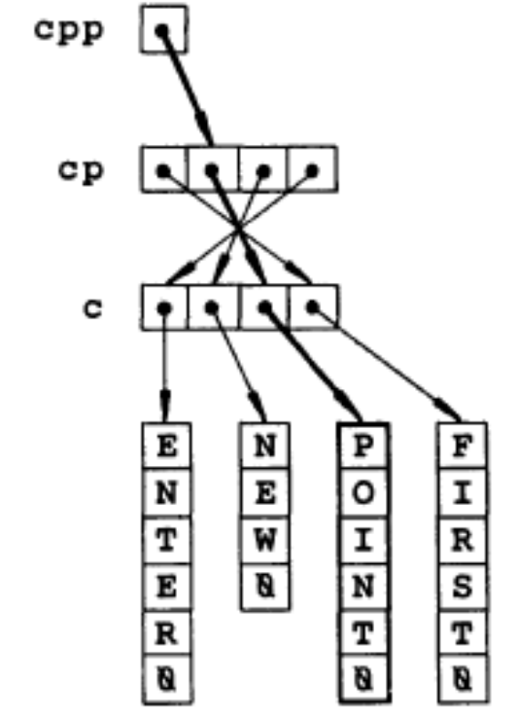
printf("%s", (*(*(++cpp))) ); //POINT

Slide 20
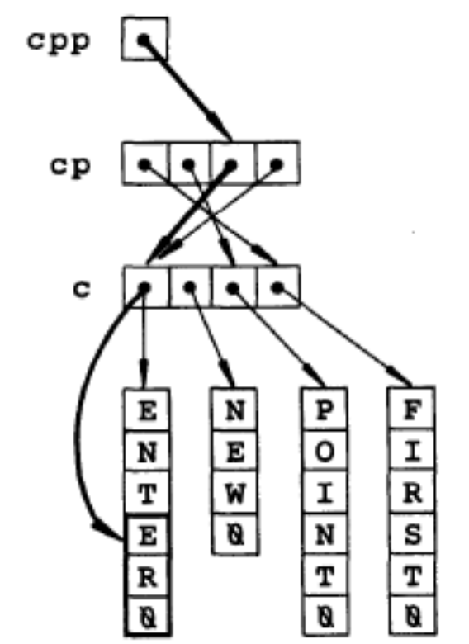
(*(--(*(++cpp))))+3

Slide 21
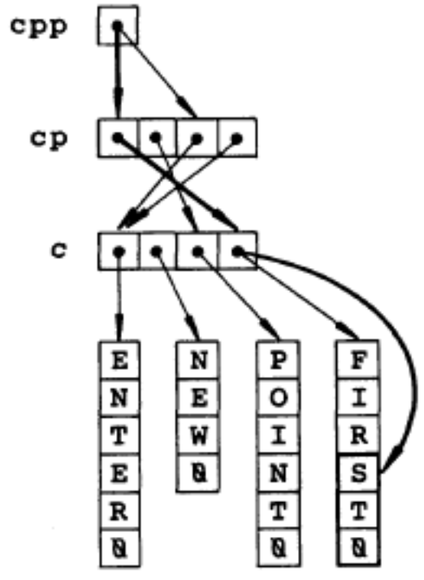
(*(cpp[(-2)]))+3

Slide 22
Difference between typedef and #define
#define string_d int*
void main()
{
typedef char* string_t;
#define string_d char*
string_t x,y;
string_d a,b;
}

